Slide 1
C# – Object Oriented Programming

Slide 2
What is OOP?
Object-Oriented Programming is a methodology or paradigm to design a program using classes and objects.
It simplifies software development and maintenance by providing some concepts.

Slide 3
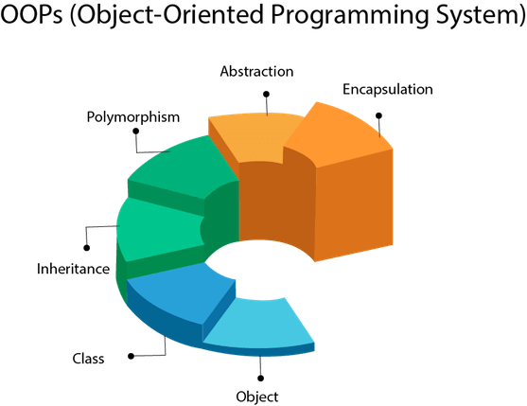
OOP Concepts
Object
Class
Inheritance
Polymorphism
Abstraction
Encapsulation

Slide 4
Advantages of OOP
OOP makes development and maintenance easier.
It provides data hiding.

Slide 5
What is an Object?
Any entity that has state and behavior is known as an object
It can be physical or logical.
An Object can be defined as an instance of a class.
Example: A dog is an object because it has states like color, name, breed, etc. as well as behaviors like wagging the tail, barking, eating, etc.

Slide 6
What is a Class?
Collection of objects is called class.
It is a logical entity.
A class can also be defined as a blueprint from which you can create an individual object.
Example: If Dog is an object, Animal is a class.
If Volvo is an object, Car is a class.

Slide 7
What is Encapsulation?
Binding (or wrapping) code and data together into a single unit is known as encapsulation.
A class is the example of encapsulation.

Slide 8
How is encapsulation implemented?
Encapsulation is a mechanism of wrapping the data (variables) and code acting on the data (methods) together as a single unit. In encapsulation, the variables of a class will be hidden from other classes, and can be accessed only through the methods of their current class.
The process of implementing encapsulation can be sub-divided into two steps:
The data members should be labeled as private using the private access specifiers.
The member function which manipulates the data members should be labeled as public using the public access specifier.

Slide 9
What are access modifiers?
The access modifiers in specify the accessibility or scope of a field, method, constructor, or class.
There are four types of access modifiers:
Private, default, protected and public

Slide 10
Understanding access modifiers
Access Modifier | within class | within package | outside package by subclass only | outside package
Private | Y | N | N | N
Default | Y | Y | N | N
Protected | Y | Y | Y | N
Public | Y | Y | Y | Y

Slide 11
What is inheritance?
When one object acquires all the properties and behaviors of a parent object, it is known as inheritance.
It provides code reusability.
It is used to achieve runtime polymorphism.

Slide 12
What is Abstraction?
Hiding internal details and showing functionality is known as abstraction.
We abstract class and interface to achieve abstraction.

Slide 13
What is an Interface?
An interface is a blueprint of a class.
It has static constants and abstract methods.
The interface is a mechanism to achieve abstraction.

Slide 14
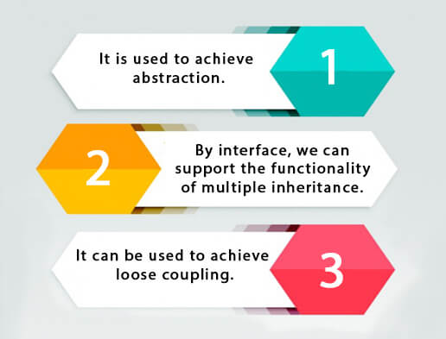
Why do we use Interface?

Slide 15
What is Polymorphism?
If one task is performed in different ways, it is known as polymorphism.
We use method overloading and method overriding to achieve polymorphism.

